Slide 1
The Stereotaxic Atlas
Stereotaxic Surgery
Histology

Slide 2
The problem
Brain Surgery poses a special problem in that usually the target cannot be located visually.
An alternate method of locating brain structures is required.

Slide 3
The Solution
A method was devised whereby brain structures are located by knowing their spatial relationships to landmarks which are visible.
This spatial relationship is expressed using a set of 3 coordinates: AP, ML, & DV.

Slide 4
AP: Anterior – Posterior
ML: Medial – Lateral
DV: Dorsal - Ventral
This is similar to the Cartesian “xyz” coordinate system that you learned in grade school. Any point on a plane can be located using the x & y coordinates (useful for graphs). By adding a “z” coordinate any point in space can be located.
There are some important differences between Stereotaxic Coordinates & Cartesian Coordinates.

Slide 5
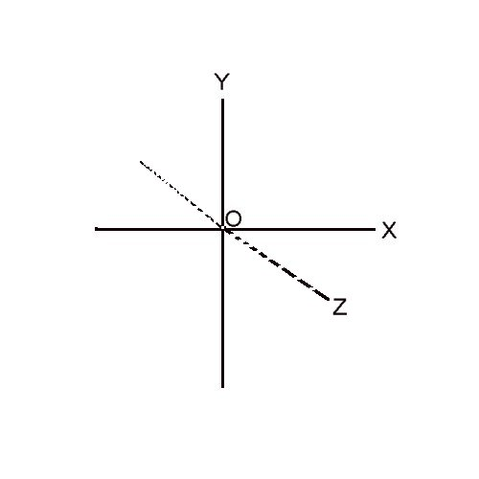
Differences
Cartesian System uses universal Reference point… the origin
Cartesian System has a single accepted orientation.

Slide 6
Stereotaxic Reference Points
The Stereotaxic coordinate system does not have a single universally accepted Reference point. In the rat the 3 most common reference points are bregma, lambda, and the IAL (IAP or Stereotaxic zero)

Slide 7
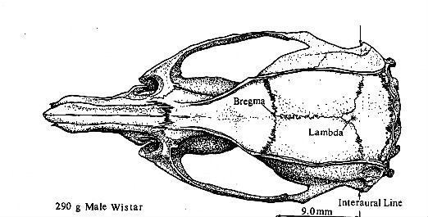
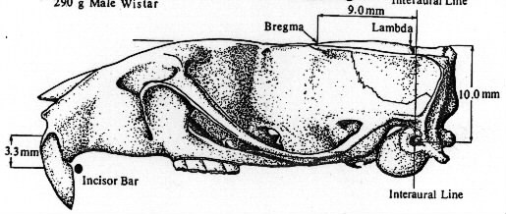
Top and side views of a rat skull.
Bregma and Lambda are intersections of bone plates on the dorsal skull surface.
The diagram indicates the approximate position of the interaural Line, but this reference point is not located anatomically. It is found on the stereotaxic instrument. (We will take a look at this later.)

Slide 8
Stereotaxic orientation
The stereotaxic coordinate system does not have a single universally used orientation.
The two most commonly used are the plane of de Groot & the skull flat plane.

Slide 9
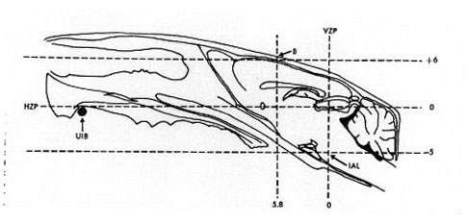
Skull Flat
De Groot

Slide 10
Stereotaxic Atlas
Stereotaxic coordinates are usually obtained from a stereotaxic atlas.
A stereotaxic atlas is a 3D reconstruction of the brain compiled from serial sections and drawings of sectioned brains.
The Atlas is constructed such that as you move from page to page you are travelling through the brain.

Slide 11
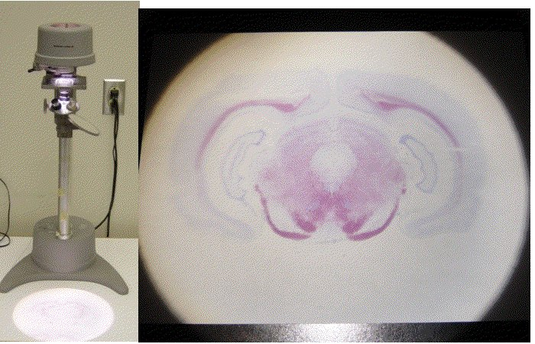
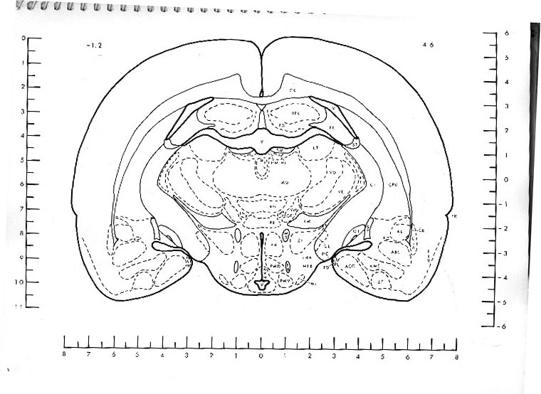
To construct an atlas, brains from a particular size, sex and strain of rat are
oriented to a specific orientation.
The brain is serial sectioned.
The sections are mounted on slides. They are then stained, coverslipped, photographed and drawn using a microprojector.

Slide 12
AP coordinate (bregma)
AP coordinate (IAL)
DV coordinate (bregma)
DV coordinate ( IAL)

Slide 13
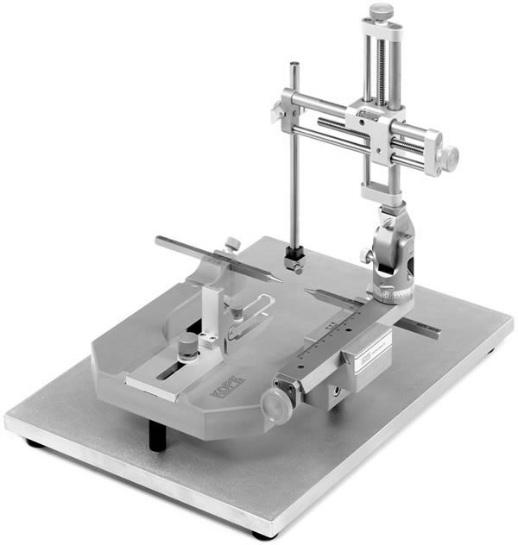
The Stereotaxic Instrument
The IAL (IAP, Stereotaxic zero)
Is the point where the ear bars meet. If you are using this as a reference point, you could place the tip of the electrode between the ear bars using the 3 drive screws. Record the AP, ML, & DV readings at this point. Structures are then located
With respect to these
Readings.

Slide 14
Electrode Carrier:
AP,ML,DV drives
Electrode Holder
Base:
Ear bars
Incisor Bar
Nose Clamp

Slide 15
The Base consists of ear bars, incisor bar, nose clamp. The base is used to immobilize the rats head at the correct orientation. Orientation is principally controlled by raising and lowering the incisor bar.
The Electrode Carrier is used to position the electrode or other device precisely in the 3 stereotaxic planes

Slide 16
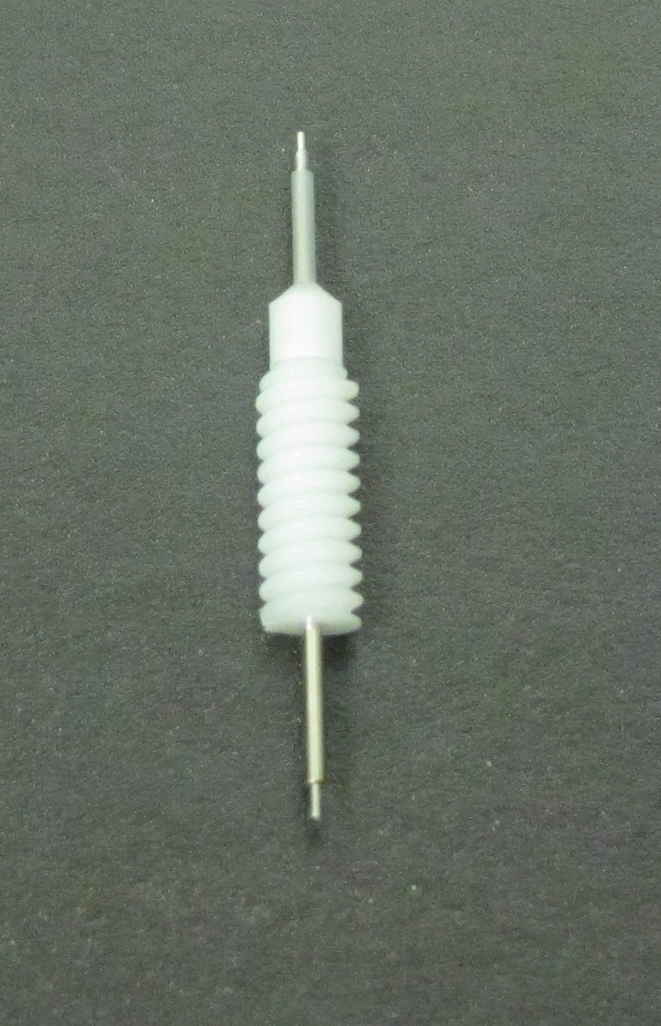
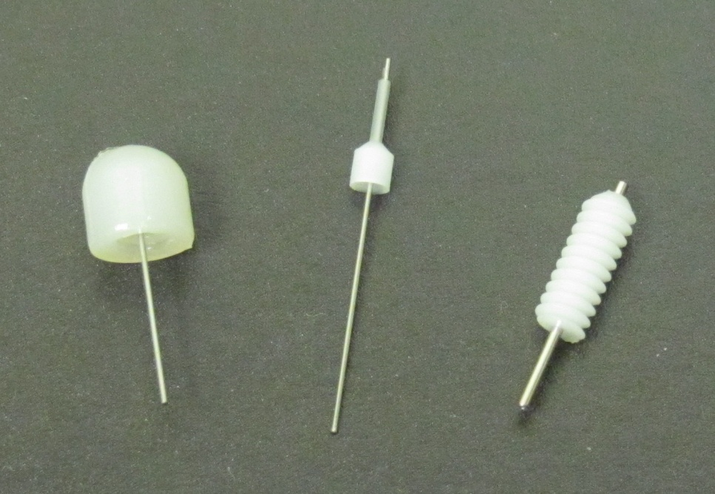
Cannula Assembly

Slide 17
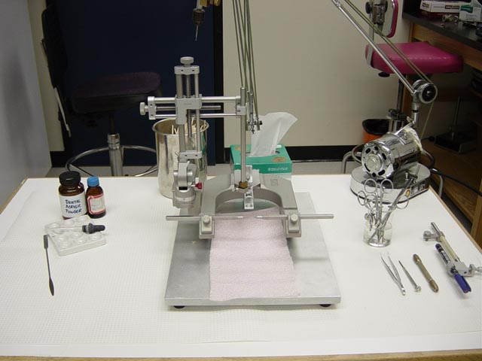
Simple Stereotaxic Procedure
Chronic implant of a bipolar stimulating electrode into the Lateral Hypothalamus.
http://play.psych.mun.ca/~smilway

Slide 18
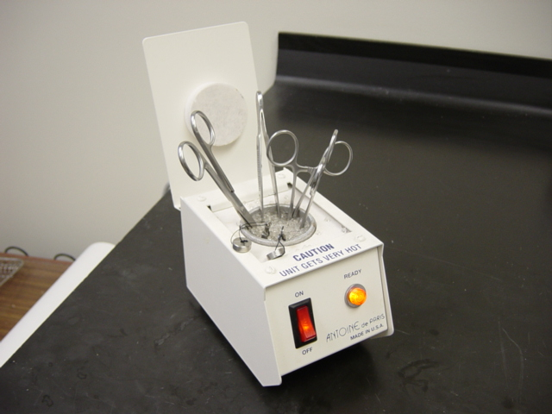

Slide 19
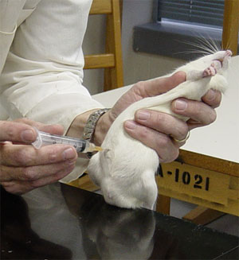

Slide 20
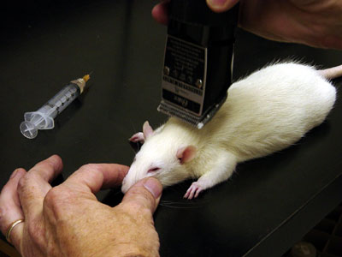

Slide 21
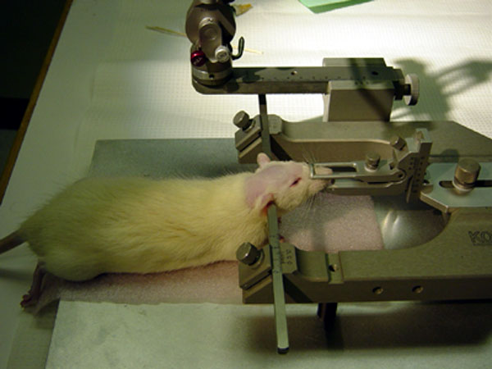

Slide 22
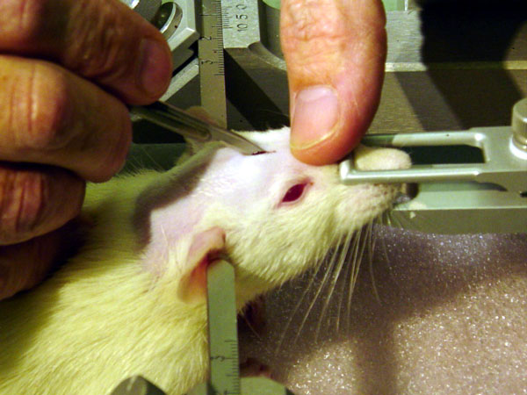

Slide 23
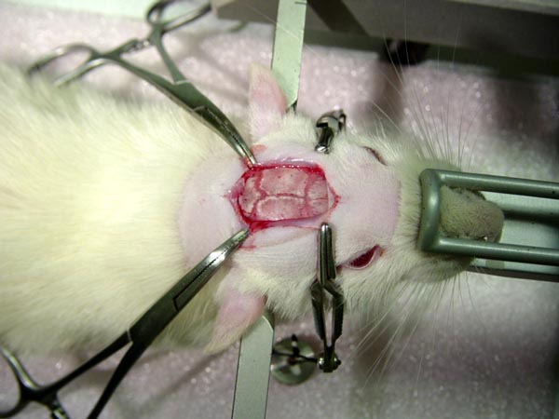

Slide 24
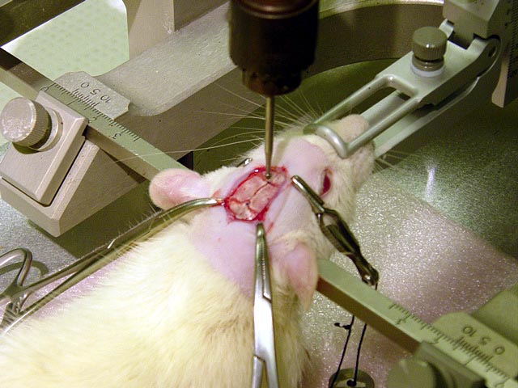

Slide 25
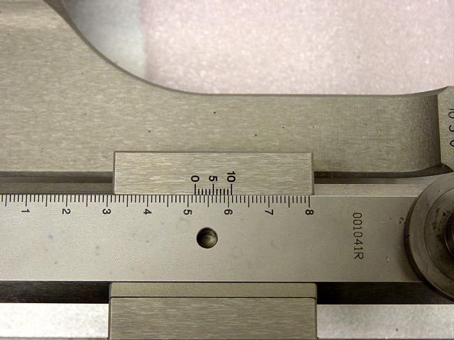

Slide 26
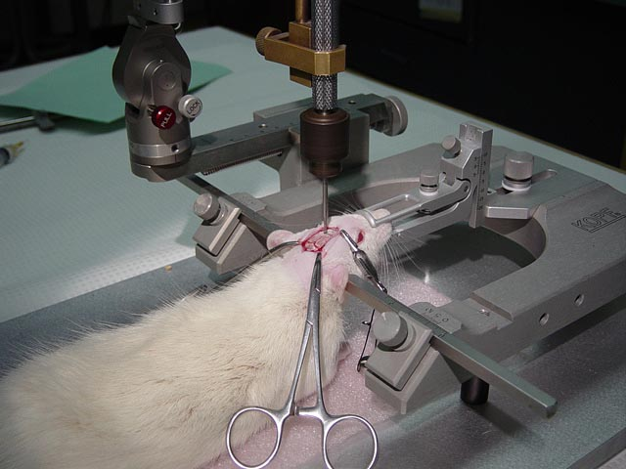

Slide 27
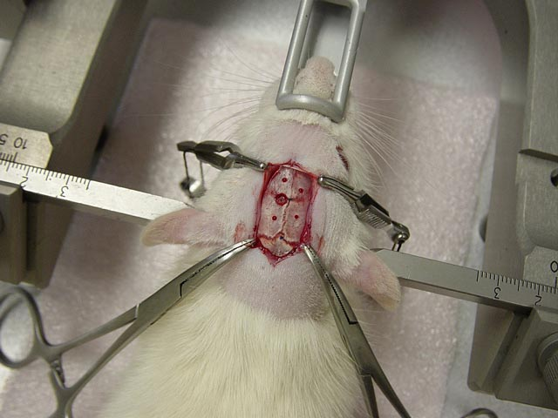

Slide 28
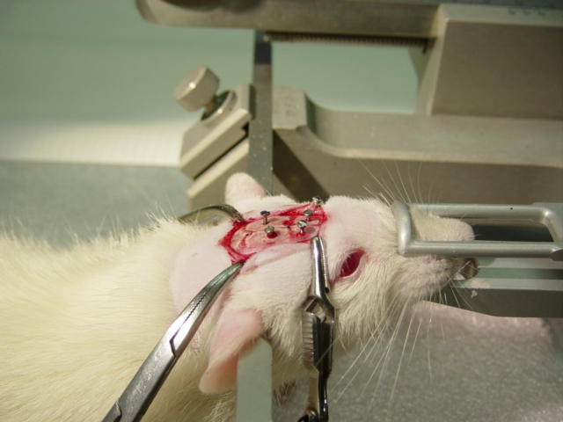

Slide 29
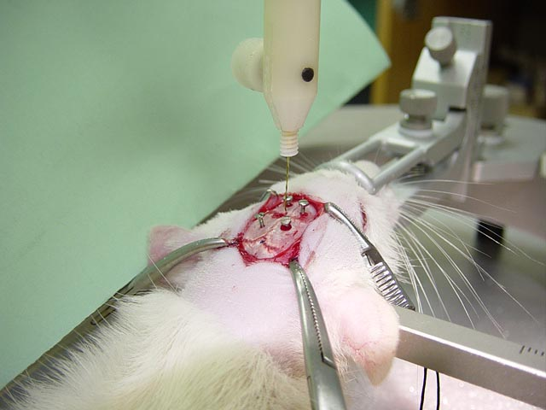

Slide 30
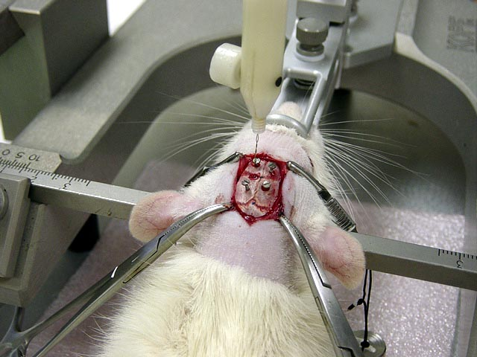

Slide 31
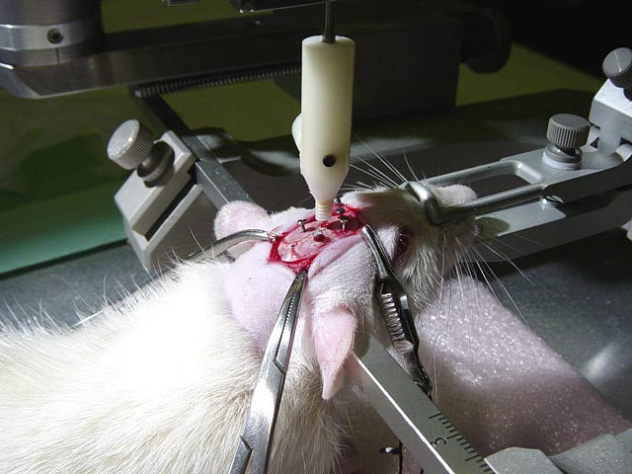

Slide 32
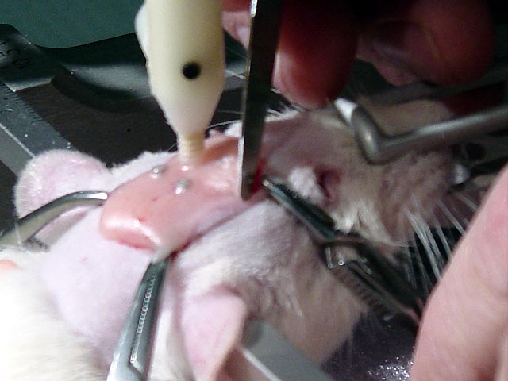

Slide 33
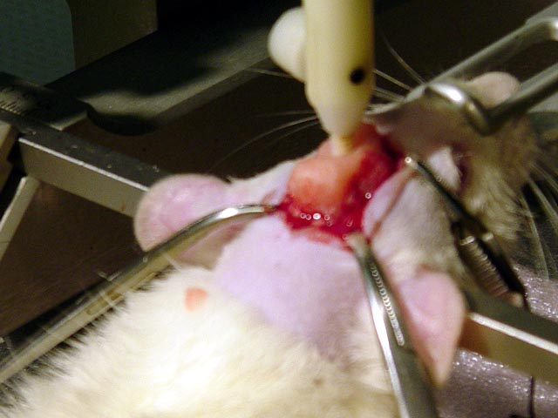

Slide 34
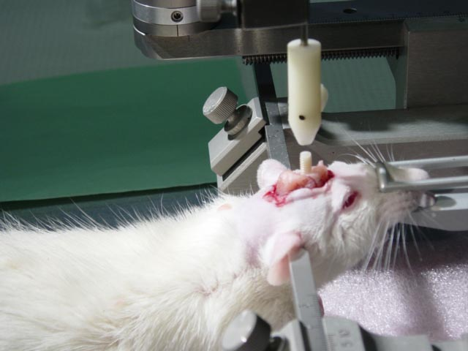

Slide 35
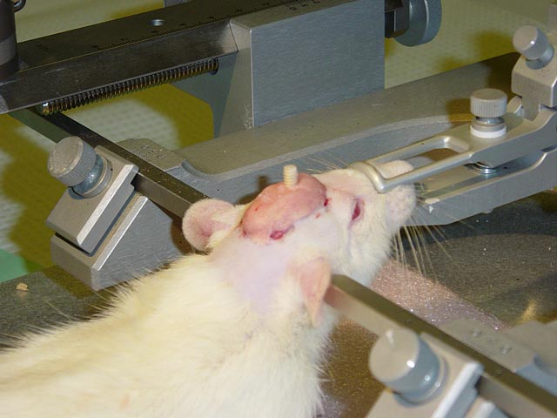

Slide 36
Histology
Fixation
Blocking
Sectioning
Staining
Microscopy

Slide 37
Fixation
When the rat is sacrificed the brain will begin to deteriorate. The onset of the deterioration is rapid.
Fixation is the procedure used to arrest this deterioration and preserve the brain for examination.

Slide 38
Fixation
Fixative Solutions
(e.g. formalin)
Freezing
(e.g dry ice liquid nitrogen, methyl butane
Immersion
Perfusion

Slide 39
Freezing vs Fixative Sol’n
Freezing is much quicker than using fixative solutions (minutes vs days).
Freezing also tends to preserve more of the brain’s biochemistry.
Formalin Fixed brains are much more resilient and are clear of blood which might interfere with visualizing cell staining.

Slide 40
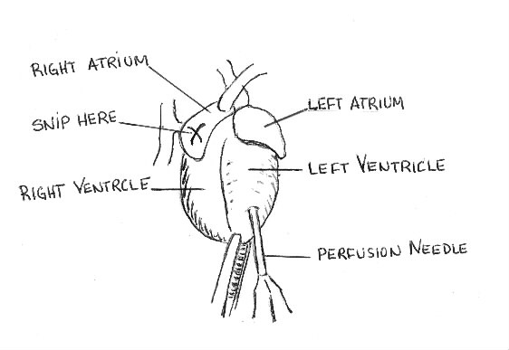
Perfusion

Slide 41
Blocking
Blocking is a very simple procedure . It takes seconds to block a brain but can save you hours.
Blocking is the trimming of the brain in such a way that it is in the correct orientation for sectioning

Slide 42
Advantages of proper Blocking
Requires fewer sections
If sectioning for electrode location, the electrode track will be more visible
Easier to identify structures because cut sections will resemble the sections in the stereotaxic atlas.

Slide 43
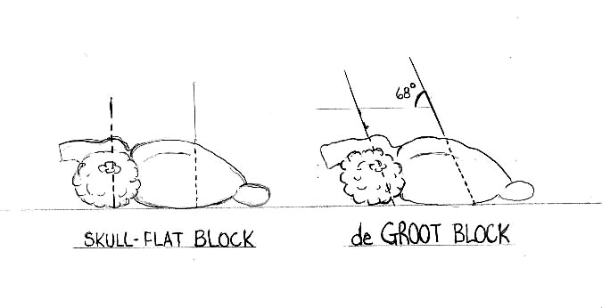

Slide 44
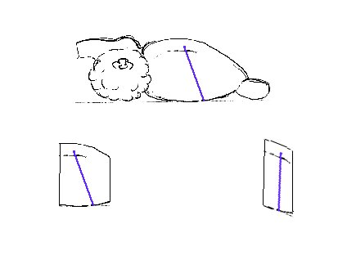
Blue line indicates location of electrode track.
Bad block
Good Block

Slide 45
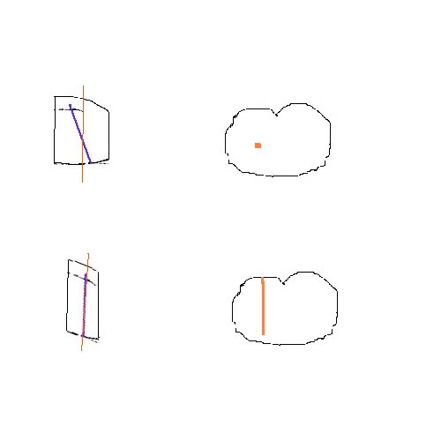
If you section in the same plane as the electrode the track is highly visible.
Also since the atlas was used to implant the electrode, If you are in the same plane as your electrode, you are in the same plane as the atlas.

Slide 46
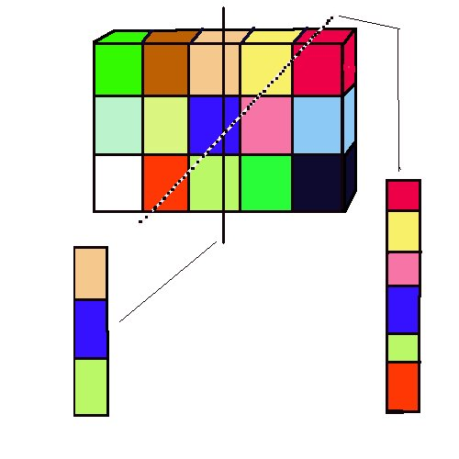
Two sections through the locus coeruleus (blue spot) can look quite different when using different planes of section.

Slide 47
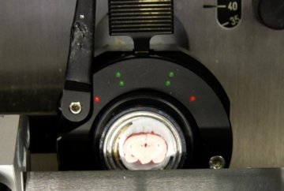
Sectioning
Sectioning will be covered by demonstration
The instrument used is a cryostat microtome.
40 µM Coronal sections of fresh frozen rat brain tissue will be taken and mounted on glass microscope slides

Slide 48
Staining
Staining will be covered by demonstration.
The stain used is Cresyl Violet, a metachromatic Nissl stain.
Cell bodies appear dark blue. Myelinated fibers stain red.
The stained slides will be coverslipped with Permount resin.

Slide 49
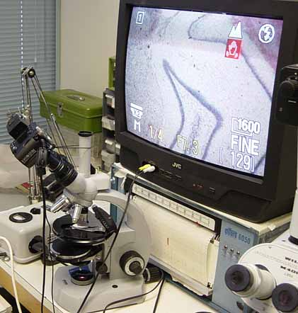
Microscopy
The sections will be examined using a microprojector.
The sections can then be traced on paper.
A scale for measurement can be included by projecting a transparent ruler onto the drawing.

